Slide 1
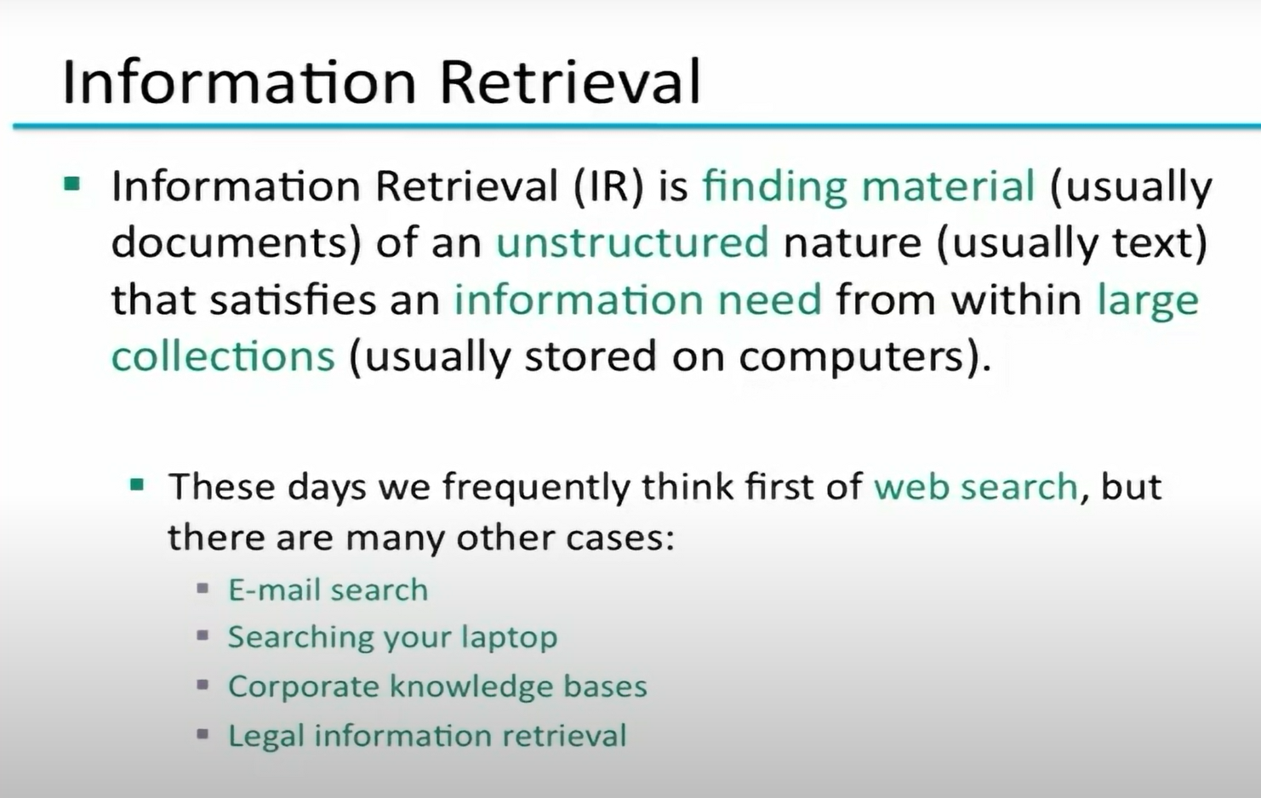

Slide 2
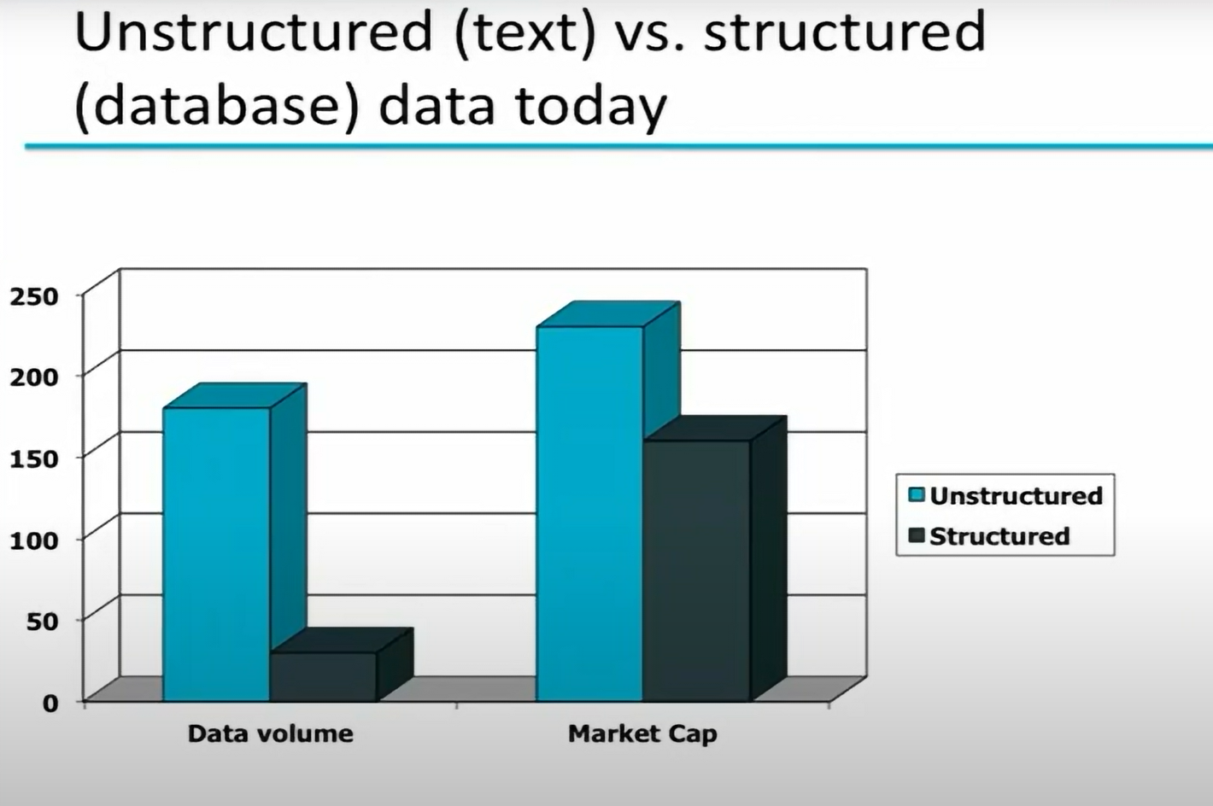

Slide 3
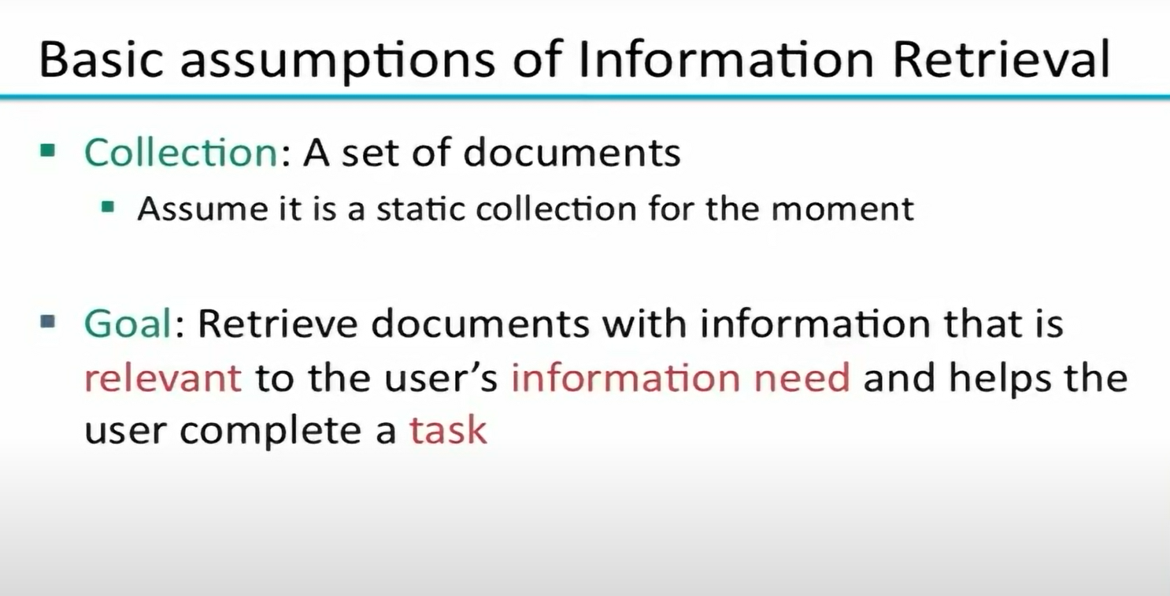

Slide 4
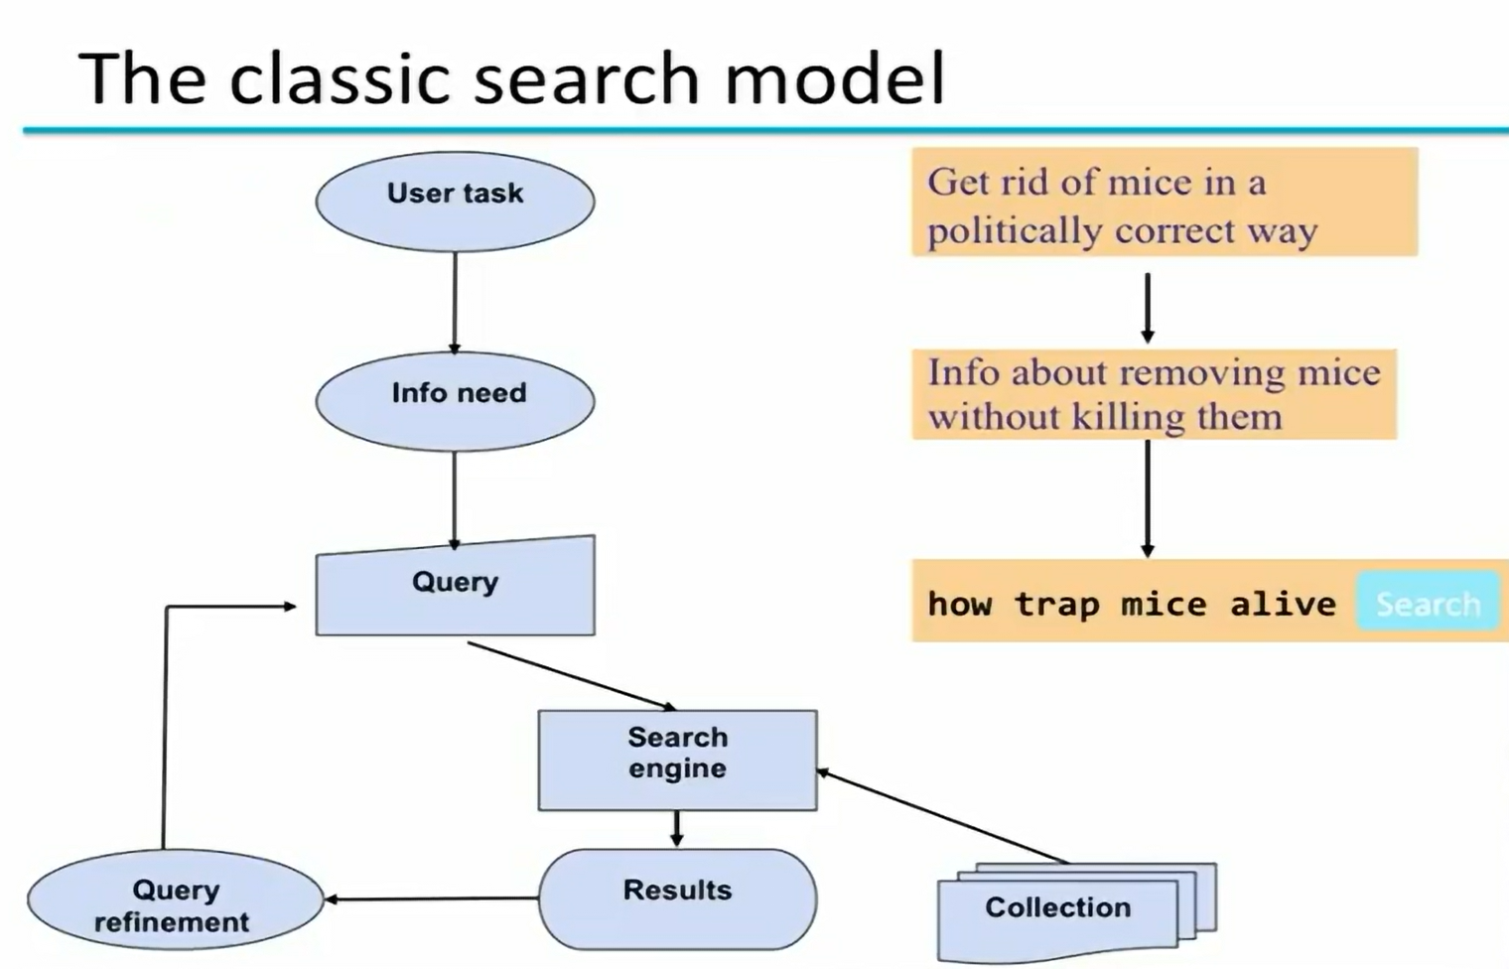

Slide 5
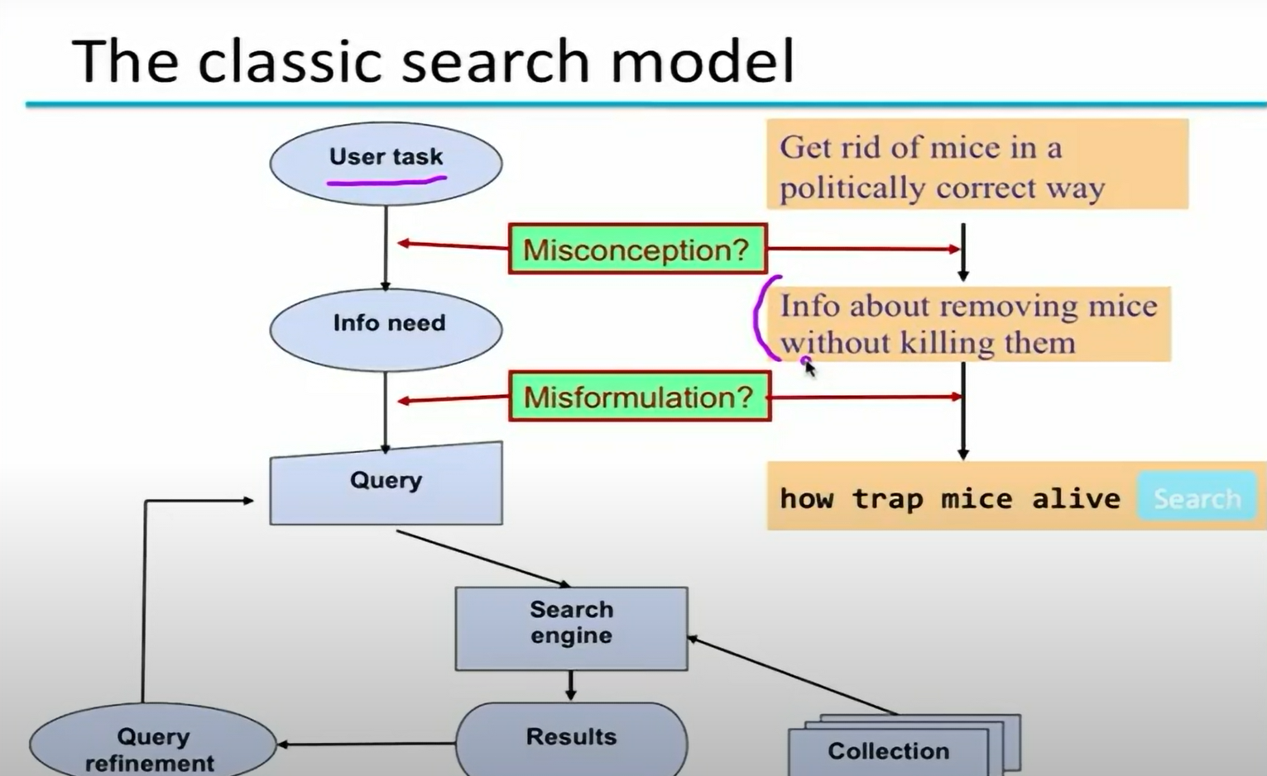

Slide 6
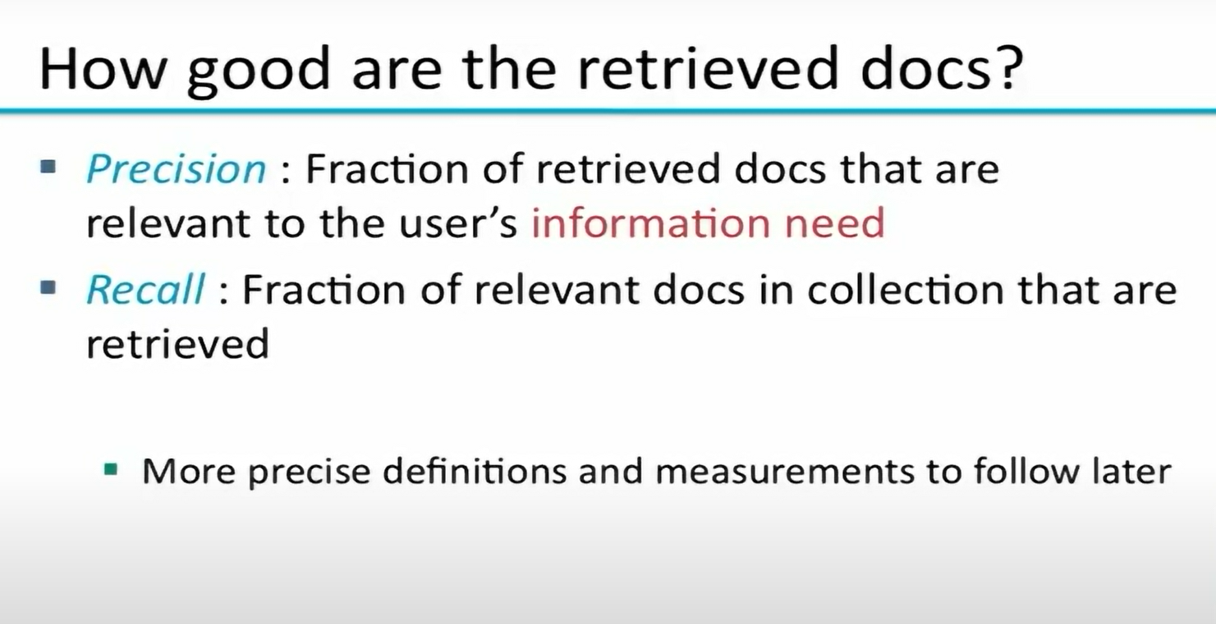

Slide 7
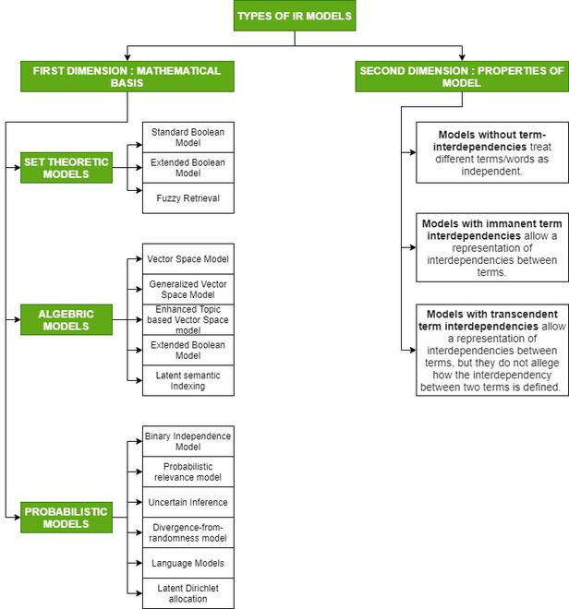

Slide 8
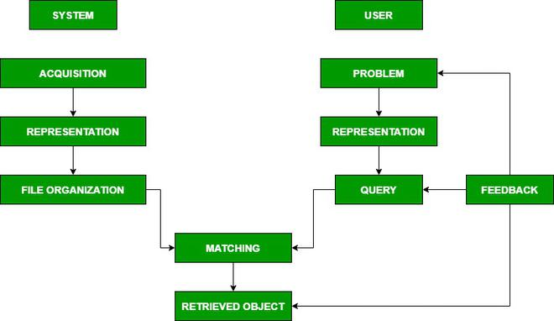

Slide 9
Nearest Neighbor Search Algorithms Search
Rapid advancements in AI have made machine learning mainstream, introducing developers everywhere to a whirlwind of new tools, techniques, and terminology. This blog explores nearest neighbor algorithms - specifically, the exact k-Nearest Neighbor (KNN) search algorithm, as well as the Approximate Nearest Neighbor (ANN) search, a variant of kNN that trades accuracy for speed.

Slide 10
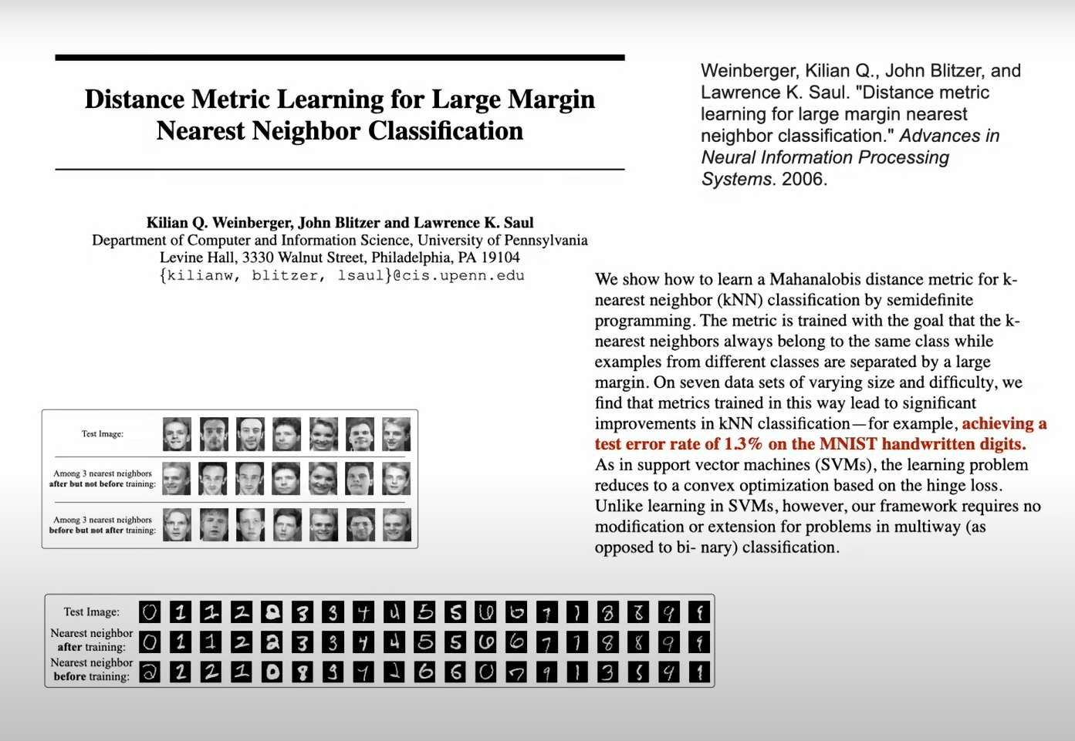

Slide 11
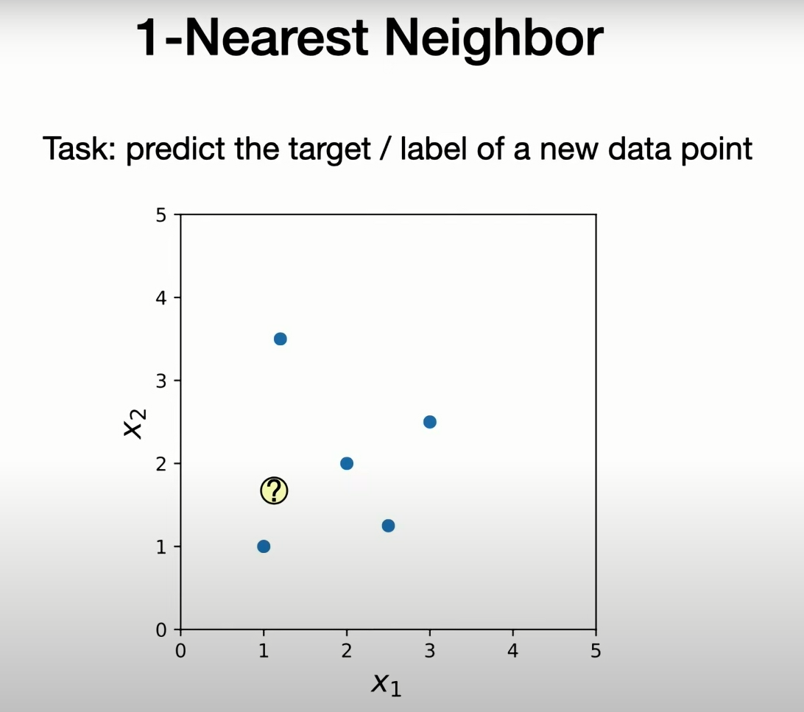

Slide 12
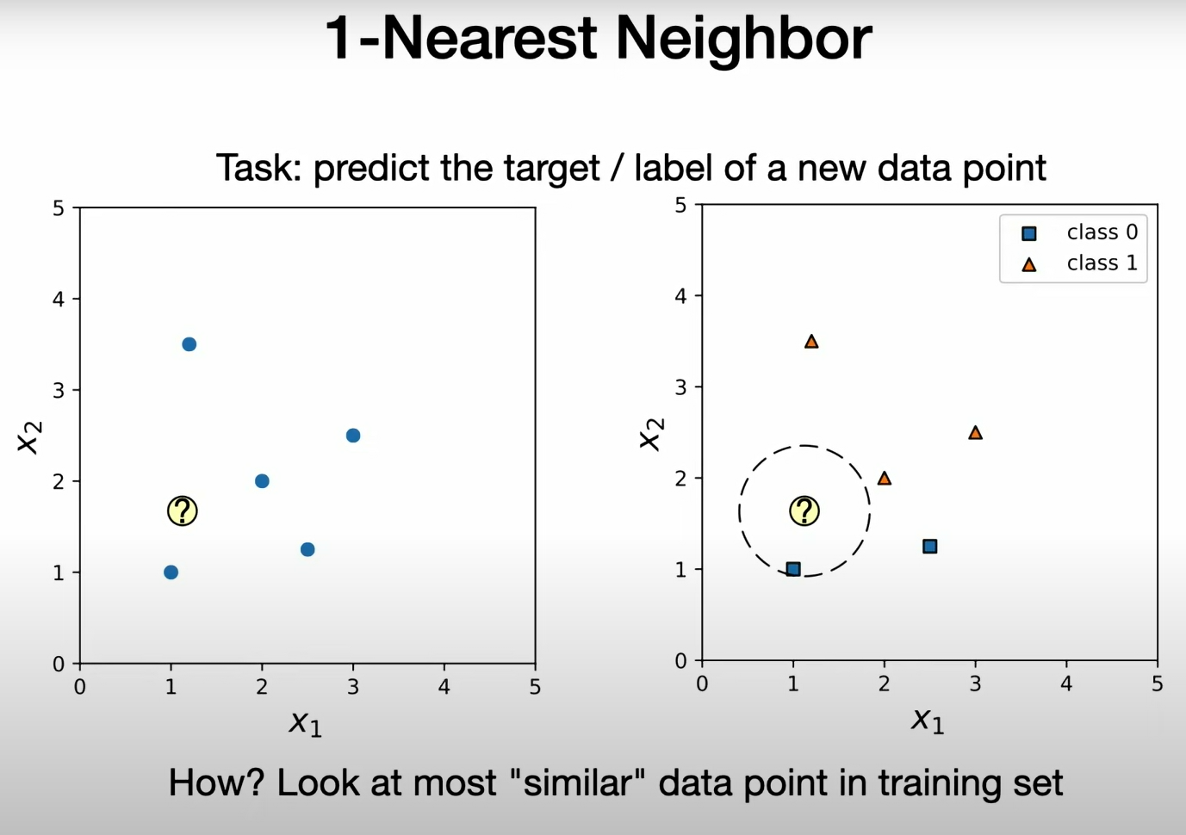

Slide 13
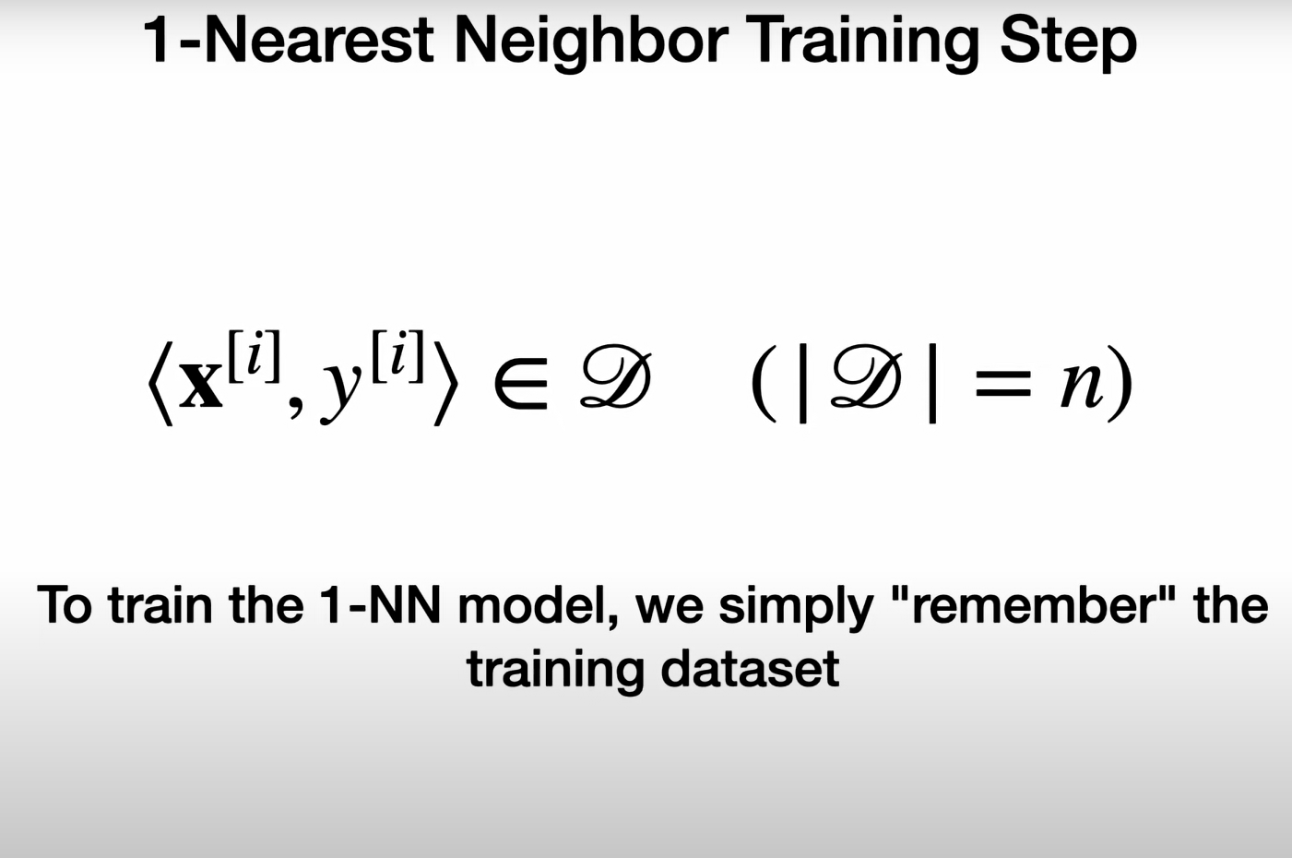

Slide 14
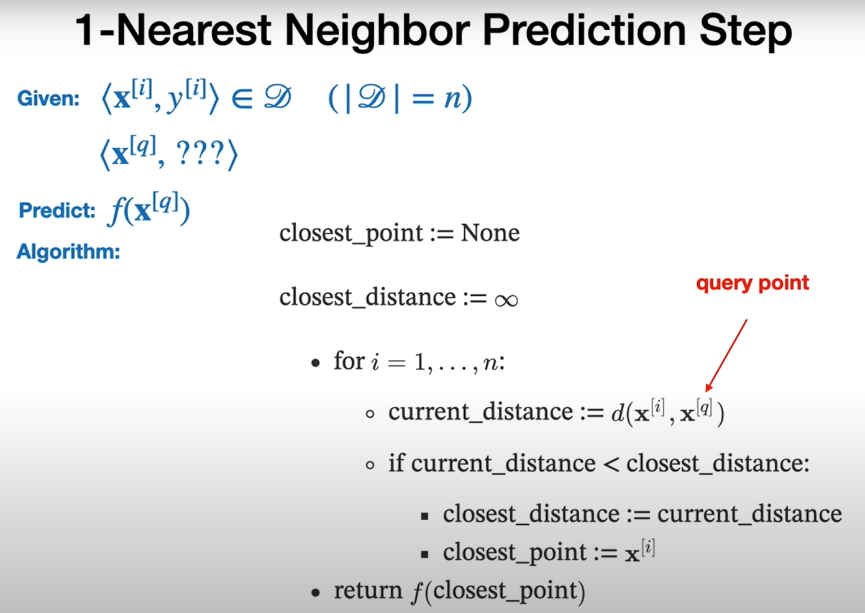

Slide 15
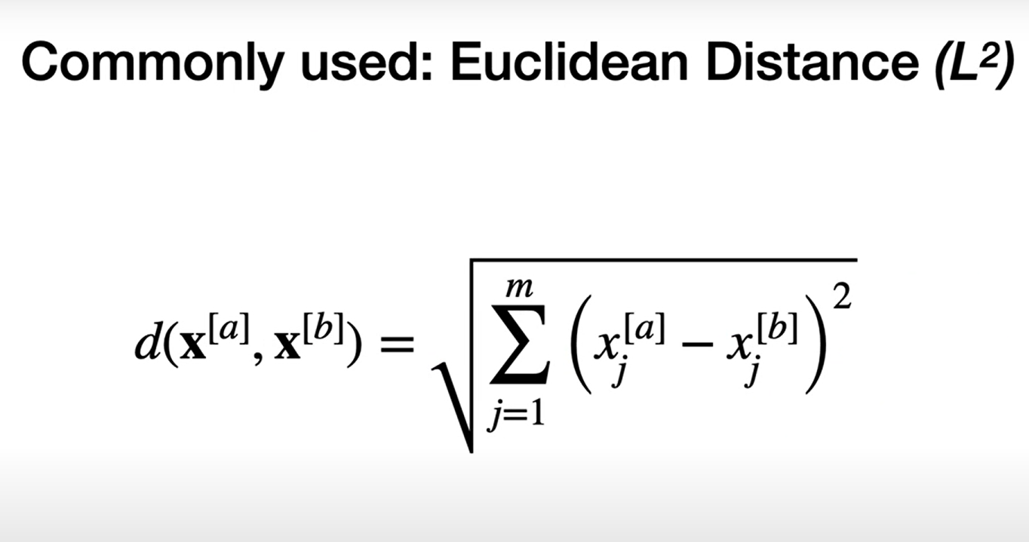

Slide 16
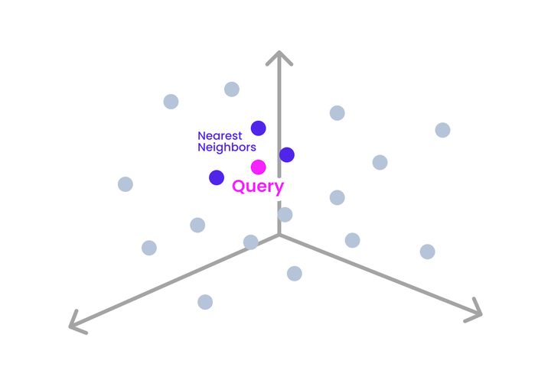
Intro to Vectors and Vector Search

Slide 17
The Exact K-Nearest Neighbors Algorithm
Choosing k
Choosing a distance measurement
The actual query run on your vector dataset
The decision made to accomplish your specific task, based on the results of your query

Slide 18
Components of a k-NN
Choosing k
Choosing a distance measurement
The actual query run on your vector dataset
The decision made to accomplish your specific task, based on the results of your query

